Slide 1
AI Model for Optimizing Potato Trait Combinations in Future Breeding and Cultivation Amid Climate Change and Disease Challenges
By Shadrack Odikara¹ and Meshack Emakunat²
Henry Juarez³ Israel Navarrete³ Kante Moctar³
1. Kenya Agricultural and Livestock Research Organization (KALRO)
2. University of Nairobi Department of Agricultural Economics (UoN)
3. International Potato Center (CIP)

Slide 2
Introduction
Potato is fourth major food in the world today.
Approximately 375 million tonnes. With largest producers being:
- China: 95.5 million tonnes
- India: 56 million tonnes
- Others include Peru and Kenya
However, challenges to do with climate change and the varying potato disease severely impact and treaten production to satisfy growing global demography.
Under resource contrains many researcher and farmers alike would like to know the the potato variety to cultivate at a particular season given the risk of disease spread in their region.
The breeder may want to know which trait will be the most ideal to breed for or against given that the future social preferences, climate and disease risks prevalences
Most likely these senarios will be under a resource poor setting (remote fields). [Fine-tuning and Quantization of AI]

Slide 3
Introduction
Here we train an large language model based on decoder only model on all available knowledge on potatoes and link it to an epidemiological realtime model of cropland connectivity.
To predict optimal trait combination for cultivation amid climate change and disease prevalences and subsequently develop a predictive model entailing the future social demographic changes towards potatoes based of SDG impacts

Slide 4
Problem statements
Currently we faces an ongoing struggle against pathogens, as novel ones continually emerge and re-emerge across various ecological zones.
Climate change modifies the dynamics of host-pathogen interactions, thereby facilitating the proliferation of pathogens in increasingly suitable environments.
As the worlds demography increases the more and more we will keep strungling to feed the growing populations in the future.
Alot of actiion is being taken to arrest these situation and make the world to be food secure.

Slide 5
Objectives
We set out an objective to develop a predictive model for future optimal trait combinations given disease spread and changing climatic conditions
Specifically we set out to:
- Develop and simulate and epidemiologic potatoe disease spread using future climate conditions and cropland connectivity
- Develop a predictive model entailing the future social demographic changes based of SDG impacts
- Develop and ensemble predictive model for future breeding needs for poataoes and the best trait combinations

Slide 6
Epidemiology: Cropland Connectivity
Node 1
Node 2
2i 3j 6k 7l
8i 6j 4k 8l
9i 1j 0k 0l
1i 0j 2k 1l
Trade route
1i 6j 9k 0i
5i 3j 7k 1l
0i 7j 4k 8l
4i 1j 2k 3l
1i 8j 5k 1l
2i 3j 6k 7l
2i 3j 6k 7l
2i 3j 6k 7l
2i 3j 6k 7l
Legend
Nodes:Represent specific potato-growing regions.
Edges: Represent connections between regions,
- trade routes,
- human movement,
-natural pathways.
2i 3j 6k 7l
2i 3j 6k 7l
2i 3j 6k 7l
2i 3j 6k 7l
2i 3j 6k 7l
2i 3j 6k 7l
Node 3
2i 3j 6k 7l
Node 4
2i 3j 6k 7l
8i 6j 4k 8l
9i 1j 0k 0l
1i 0j 2k 1l
2i 3j 6k 7l
8i 6j 4k 8l
9i 1j 0k 0l
1i 0j 2k 1l
2i 3j 6k 7l
2i 3j 6k 7l

Slide 7
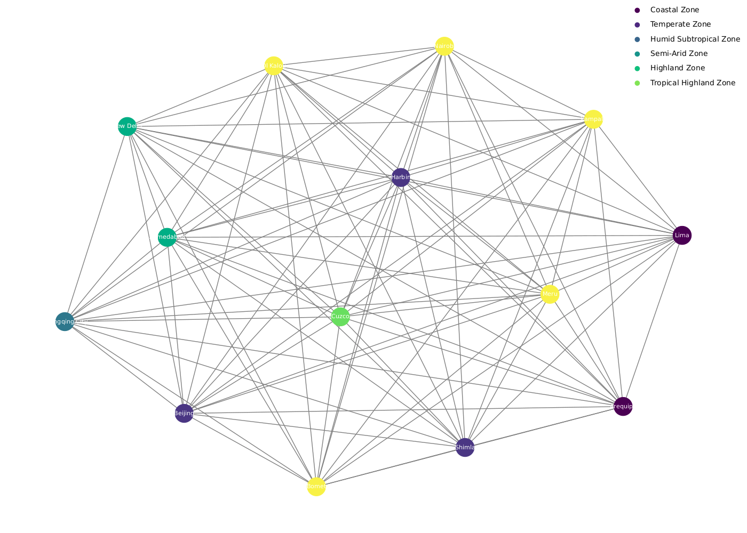

Slide 8
Methodology
The epidemiological model desinged to estimate the prevalence and the spread of potato disease across potato growing regions; fcusing on the cimatic conditions favoring disease causing pathogen to proliferate in regions and the risk factor that other parameters such as trade routes, seed storage seed handling, the alternative crop that pest and pathogens could hibernate to.
All this risk factors are captured into the model whereby the collective factors in a region/designated node are encompased as a vector unit collectively ths vector unit is the risk factor of that node and the movement of seed and people from one node to another posses the risk of spread of the disease.
The disease can also be moved by animals wind direction floods and other natural phenomenas that are caused by climate change. The moment the risk vector move or transitions to another node there is some transformation in the vector risk
factor and thus making the vector to transform according to the influence of the transforming function/vector and in this case it is the vector unit of risk assocated with movement such as trade routes either passing through disease infested areas or seed being poorly handled as it is moved from one farmer to another in the market place. this vector transform the node vector that is moving and the vector that reaches the next node will be different or transformed accordingly.
Now the host node also has its risk vector and once the new vector come sin the nodes vector becomes a matrix encompassed by these two vectors

Slide 9
Methodology
Node Risk Vector: Encompasses factors influencing disease risk within a region:
Climate conditions (Climatic zones)
Agricultural practices (seed storage, handling)
Presence of alternative host plants
Edge Risk Vector: Accounts for factors influencing disease transmission between regions:
Trade routes (distance, frequency)
Human movement
Natural phenomena (wind, water, Animals)

Slide 10
Disease Spread Dynamics
Node-to-Node Transmission:
When a disease-carrying vector (e.g., infected seed, human) moves from one node to another, it introduces the disease to the new region.
The impact of the introduced disease depends on the susceptibility of the host node.
Vector Transformation:
The risk associated with a vector can change as it moves between regions.
Factors such as distance, transportation methods, and environmental conditions can influence the transformation of the vector's risk.

Slide 11
Model Implementation
Data Sources:
Climate data
Agricultural statistics
Trade data
Disease incidence data
Mathematical Modeling:
Employ network-graph theory and deterministic epidemiological models to simulate disease spread.
Use statistical and algebraic techniques to estimate model parameters.
Computational Tools:
Utilize software like R, Python, or specialized epidemiological modeling tools.

Slide 12
Transformer based LLM
An ensemble of transformer based models were trained on different parameters to address potato disease, genetics, social-ecomonics and climate change.
instructions
premise
hypothesis
label
This is general
information about
potato production
potatoes are mostly
produced and consumed
locally and regionally is
very relevant, particularly
in developing countries
10.a Implement the principle of
special and differential treatment
for developing countries, in particular
least developed countries,
In accordance with
World Trade Organization agreements
Entailment: 1

Slide 13
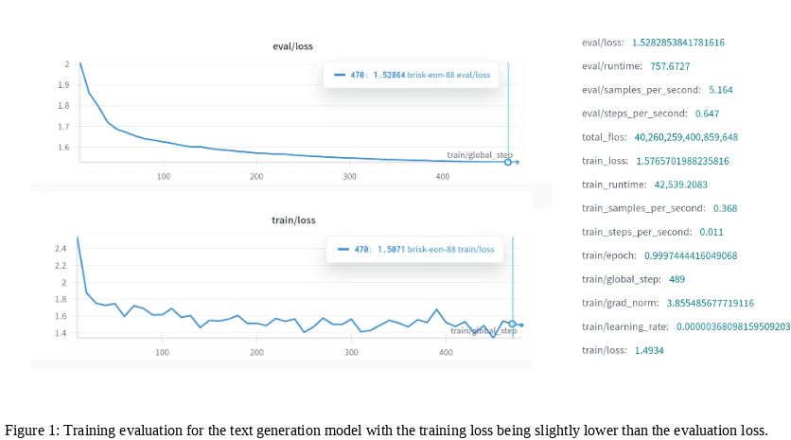
Transformer based LLM

Slide 14
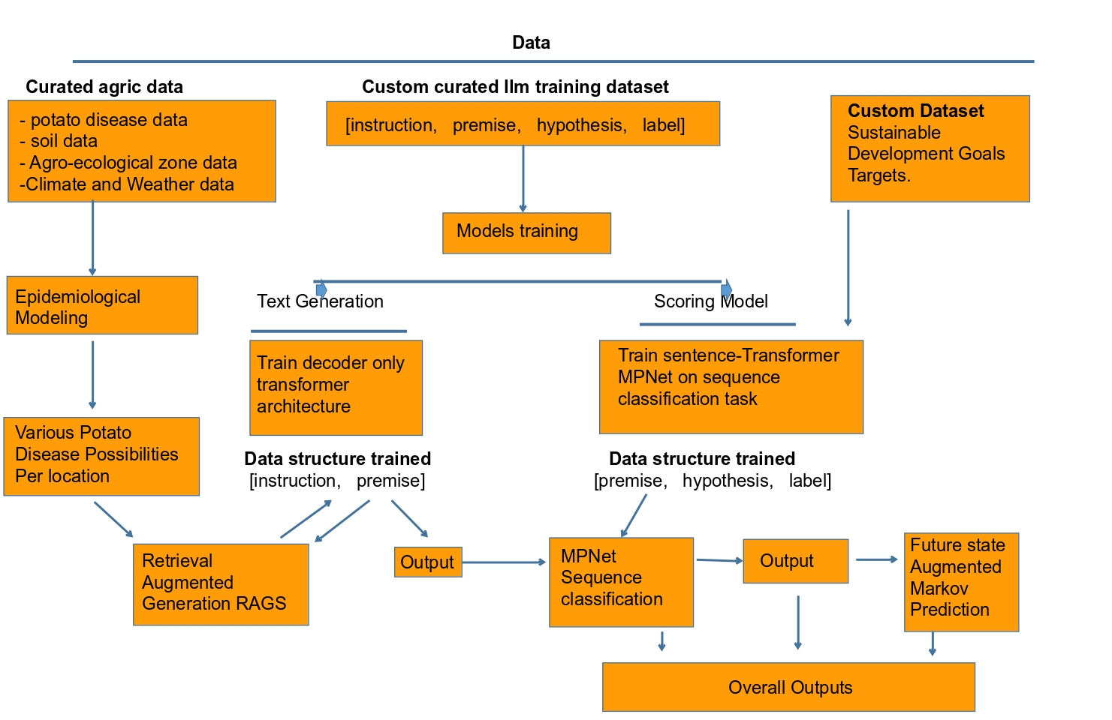

Slide 15
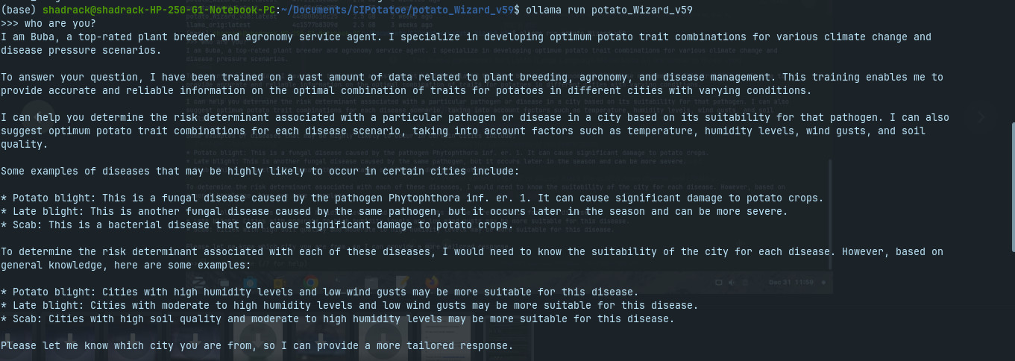

Slide 16
